Slide 1


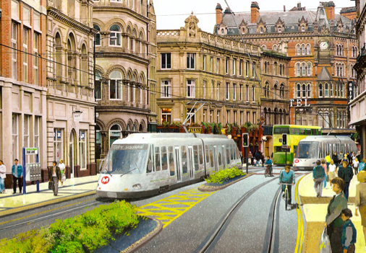
Leeds Supertram 3
Presentation 12th Dec. 2016 by
Lincoln Shields and Colin Dyas

Slide 2
National Audit Office Report (2004)
Tramways too expensive
Optimistic patronage forecasts
CAPEX under estimated
Each with different contract – high legal costs
Economic and social disruption in construction
Green Light for Light Rail DfT Report (2011)
Only if costs come down to other EU levels
Then came Edinburgh !

Slide 3
Issues for today ?
Pollution
  N.I.C.E Report on toxic traffic air pollution:
    “public health crisis of our generation”.
    Kills over 40,000 pa in UK
  Kills c 700 people in Leeds pa.
  cost to the NHS £480m pa.
  Leeds worst: local smog spot - and third nationally
  Leeds will breach limits of air pollution past 2020
  Tyre and tarmac debris more than legal limit of PM10
Northern Power House
  Manchester Metrolink; unlocking economic investment
  Buses major source of pollution, don’t get people out of cars
Local Issues
  Failed Scott Hall Road Busway ? No change in modal split in 20yrs.

Slide 4
Preston GUILD Line - a new approach
Community support for trams
  80% residents, 75% businesses, 87% in on line poll
Privately promoted
Commercially based
Financially viable
CAPEX reduced
Planning Approach
Council Support
  Local Plan 2012-26

Slide 5
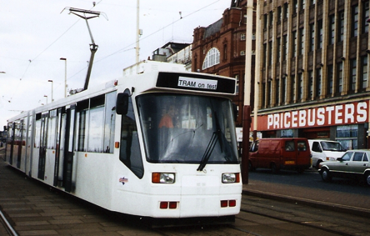
GUILD Tramway Economics
18,000 residents along line will make:
  1.8m trips pa. , >30% from cars
No external trips included
  e.g. P+R & Rail, and Deepdale Retail Park uncertain
Revenue based on local bus fares (£1.75/trip)
Capital cost: £25million
  6km line, 4.5km off street
Operating cost c £2m pa.
IRR > 5%pa.
Commercial funds

Slide 6
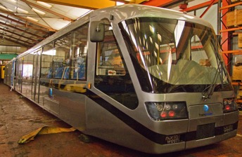
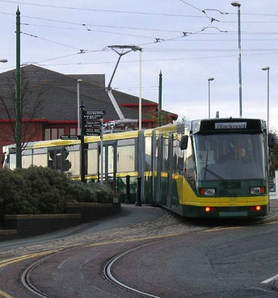
City Class Tram
100% flat floor
Low floor 300mm high
Braking
  Service = 1.5m/s² no jerking
  Emergency = 3.3m/s²
No wheel squeal
Sprung wheels= smooth ride
Automatic slip/slide control
No sand needed
8% gradient - 20m reverse curve

Slide 7
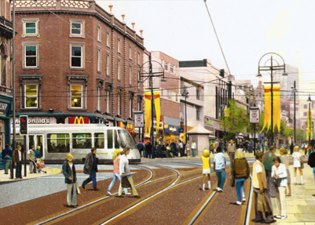
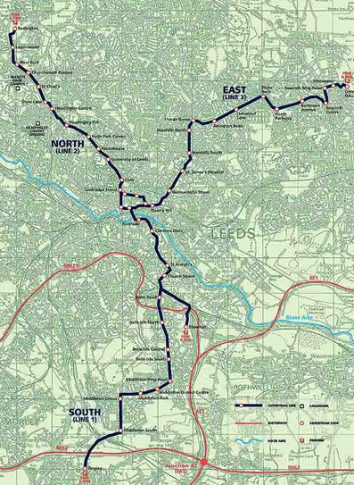
Leeds Supertram 2 (2003)
CAPEX
Utility = £100million
Track = £100million
Trams = £70million
Other = £130million
TOTAL= £400 million
Cancelled by Chancellor Alistair Darling 2005

Slide 8
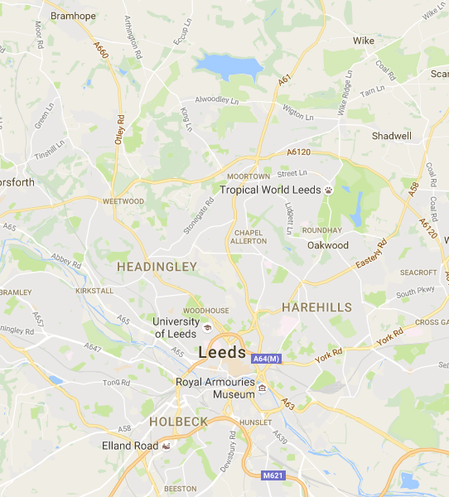
Leeds Supertram 3
Prepared by Trampower
City Centre Options
Tram Stop
M621 P+R

Slide 9
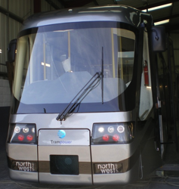
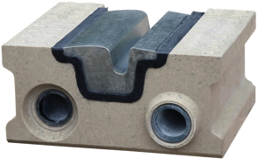
Supertram 3 CAPEX
Item | Supertram 2 [2003] (£million) | SUPERTRAM 3 [2016] (£million)
Track | 100 | 70
Utilities | 100 | 30
Trams | 70 | 20
Other | 130 | 20
TOTAL | 400 | 140
Route length (km) | 28 | 14
Cost (£million)/km | 15 | 9
LR55 Track simplified OHL City Class trams

Slide 10
The Partnership
Private sector promotes
  raises the funds
  Constructs
  operates
Public sector
  Approves (planning permission)
  Buys out later, and operates ?
The community
  Gets many benefits
    Acceptable travel choices
    Less toxic air, illness and premature deaths
    Less noise and safer streets
www.trampower.co.uk

Slide 11
Conclusion
People like trams (Circa 80% support)
Commuters leave cars at home, or Park+Ride the tram
Reduces traffic (gets people out of cars !)
  Complementary management
  Tram priorities
  Prevent suppressed car trips clogging roads
Less congestion
Better air quality
Improves access and connectivity
Raises investor confidence for other projects

